Slide 1
Integration of Multiple Static Analysis Tools in a Single Interface
Status Quo – 15.07.2019
G. S. Varma

Slide 2
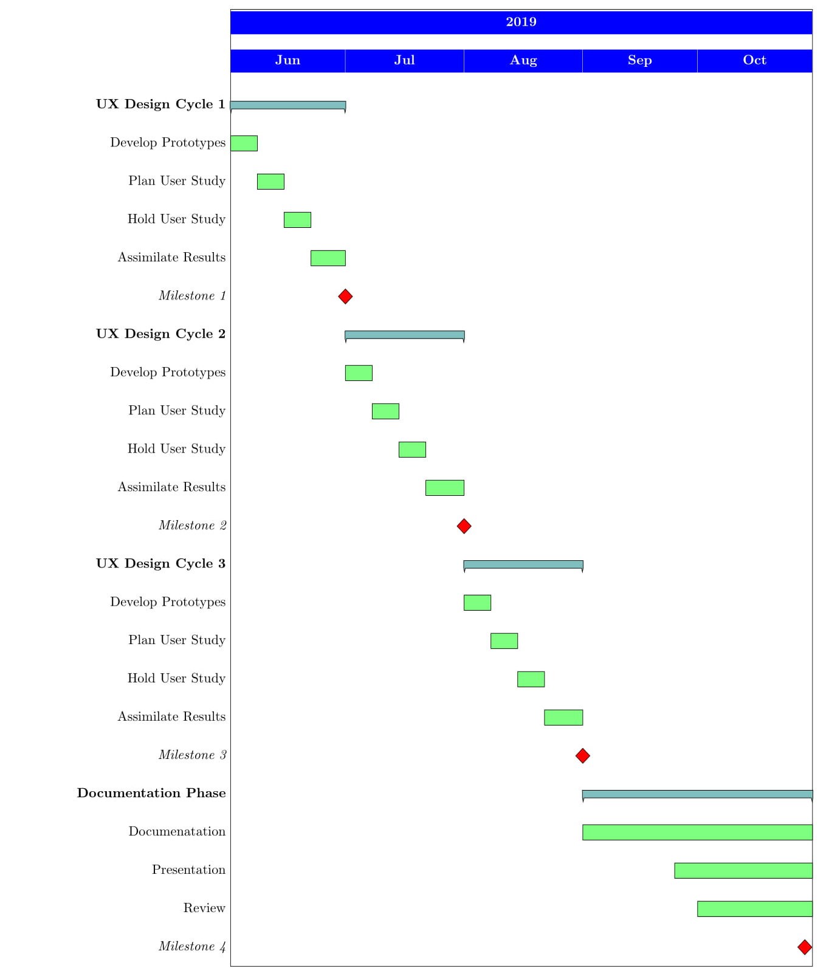
Time Plan
done
in progress…

Slide 3
UX 2
Improvisations over UX 1:
Code base improved
Volume of bugs increased ( + scroll )
Code view ideas addressed in addition to new ideas

Slide 4
UX 2
 | Analysis View | Code View
RQ 1 ( display ) | Single List Separate List Tags | Separate Icons Single Icon
RQ 2 ( feedback ) | Animated Icons Progress Bar Popup | Toasts ( alerts ) Spinner ( status )
RQ 3 ( trace ) | Numbers Adjectives | Before/After

Slide 5
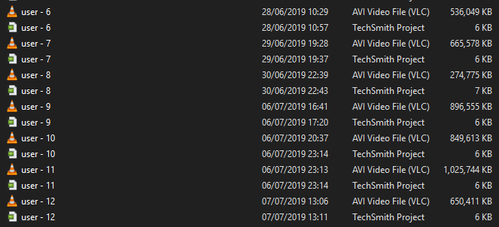
User Study ( UX 2 Raw Data )

Slide 6
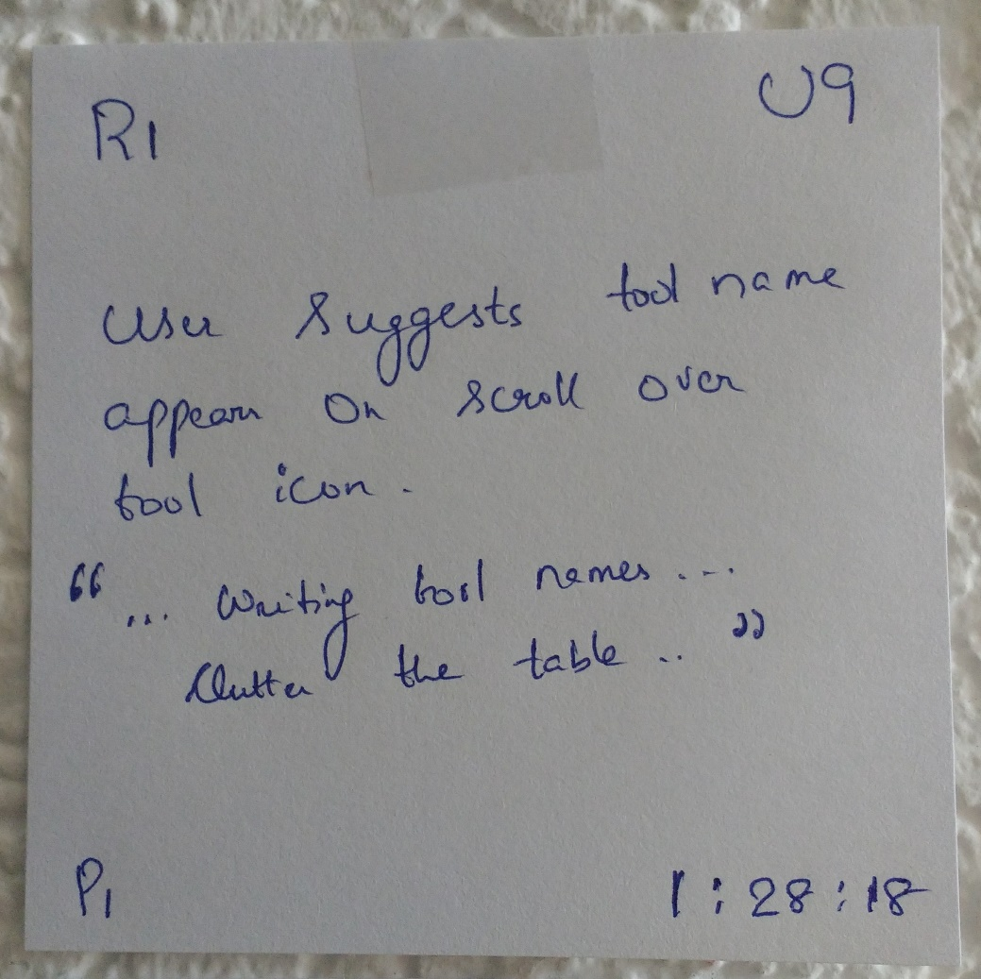
User Study ( Affinity Note)
Factual statements
Observations
Quotations

Slide 7
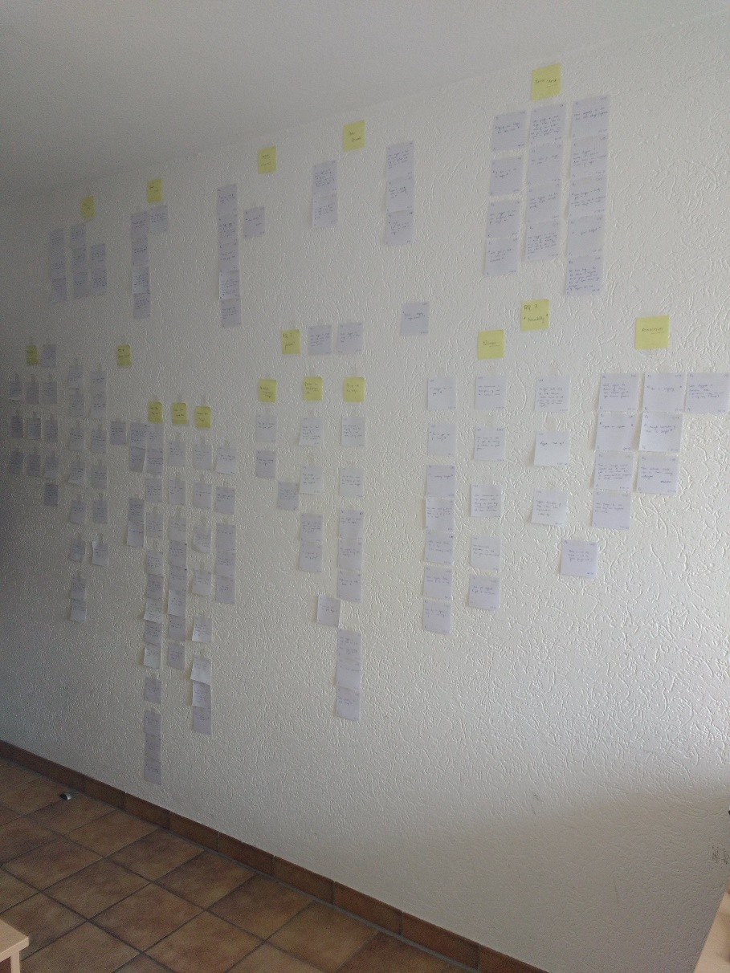
User Study ( Affinity Wall )

Slide 8
User Study (Results)
Quantitative data – excel [ added in git repo ]
Qualitative data – affinity
No idea is blacklisted
Most users preferred to see combinations in end product

Slide 9
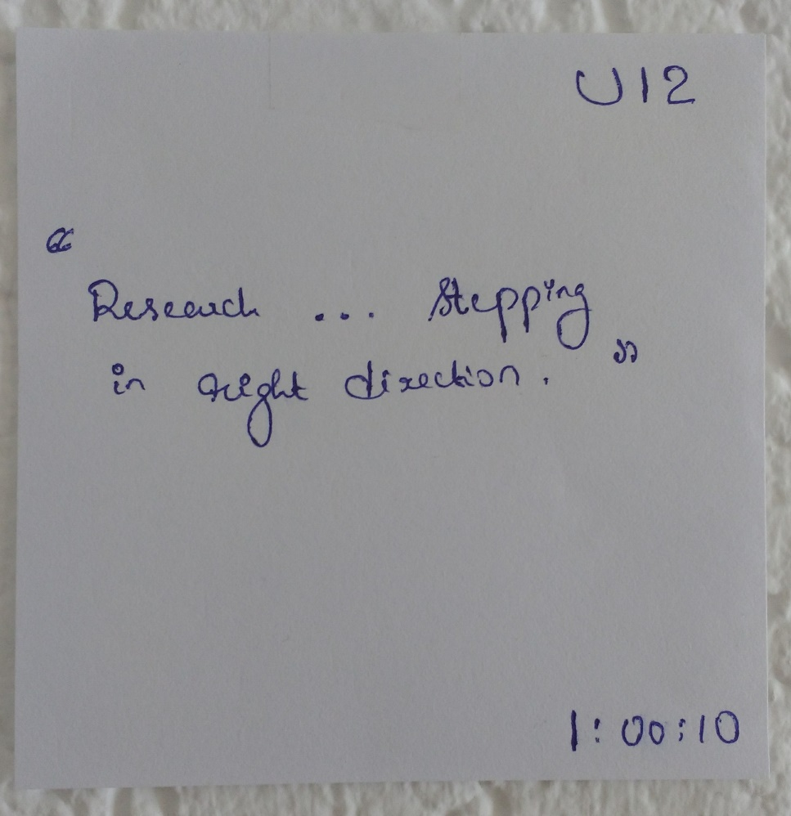
User Study (Results – positive remark)

Slide 10
Limitations of user study
Mock up screens jump on out of scope clicks. - this might distract user working memory
RQ 2 - No animation effects by mock up tool.
- but tried to help user understand the scenario

Slide 11
UX 3 - Vision
Explore new ideas
( Or / both )
Converge to a usable prototype
to be decided

Slide 12
UX 3 - explore
 | Analysis View | Code View
RQ 1 ( display ) | Tabs for tools Graphs Categories for bug | Bugs button to a file ( shows tool wise / bug type wise )
RQ 2 ( feedback ) | Timed reports ( ex: on login )
RQ 3 ( trace ) | Icon for previous attempted fixes

Slide 13
UX 3 - converge
Improvise the existing ideas to a single ( or more ) prototype
Perform SUS / Attarkdiff usability study
Conclusion: one usable prototype

Slide 14
Coming up ( July )
22.07 meeting – prototypes / protocol approval
30.07 meeting – accomplish UX 3 interviews

